Slide 1
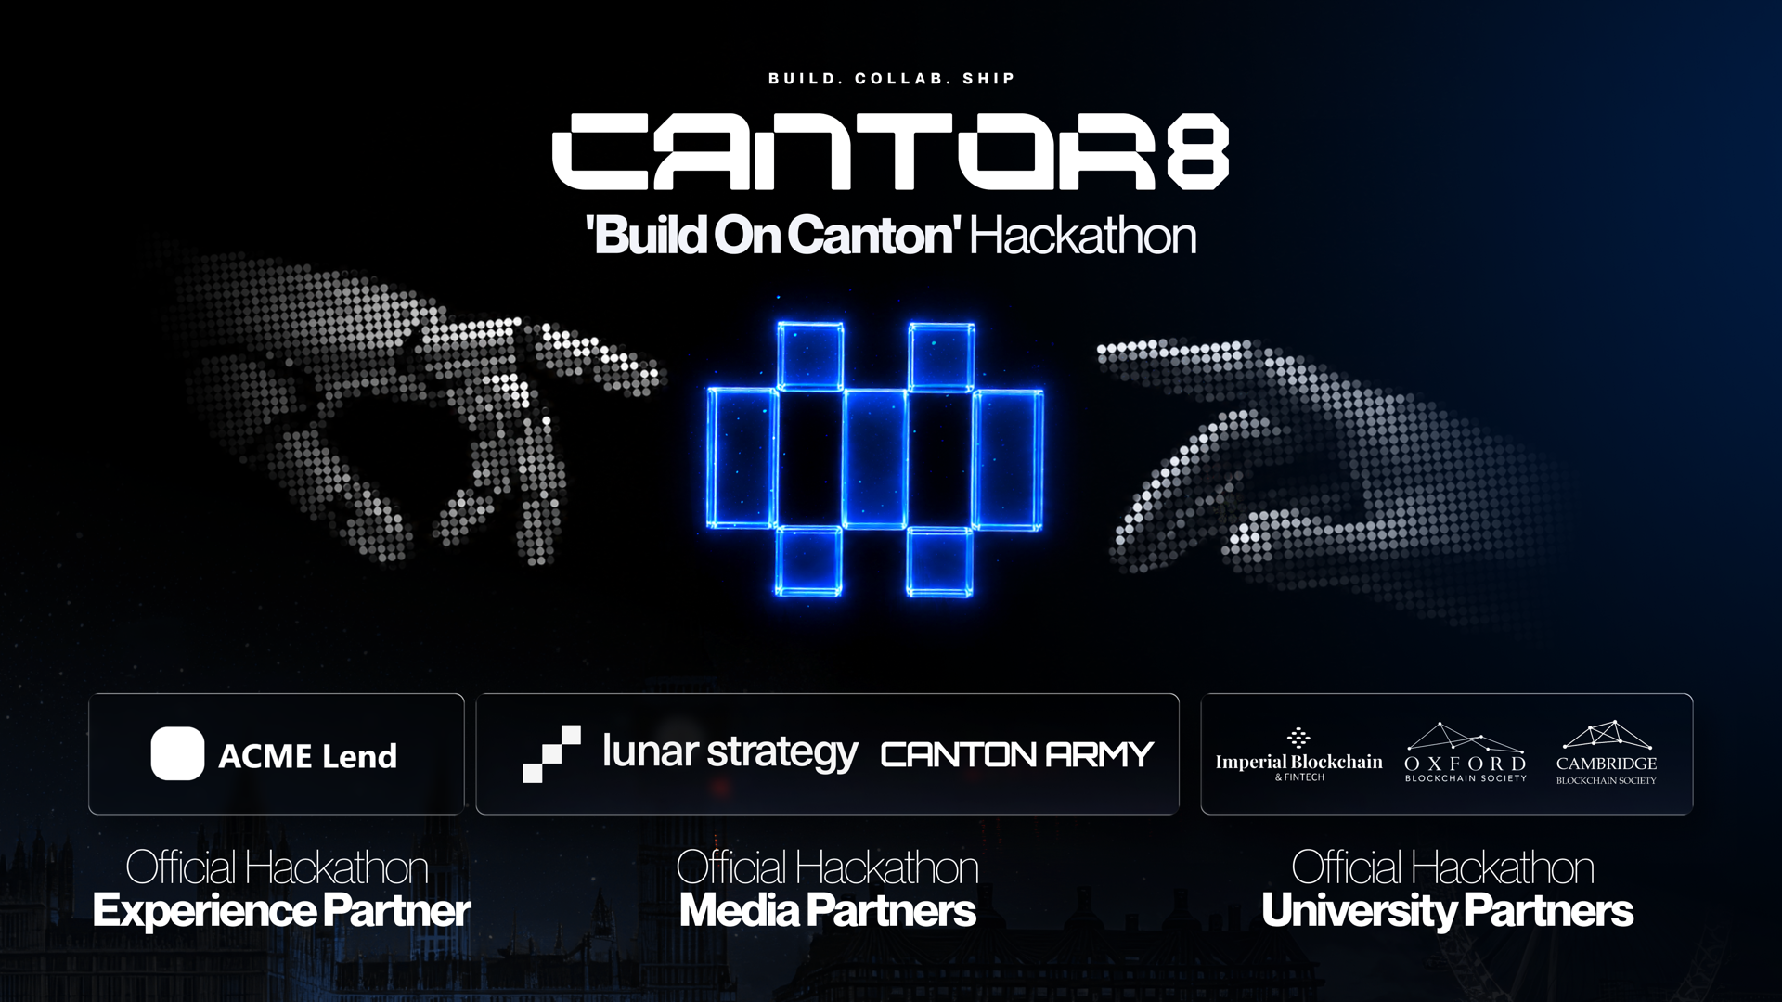

Slide 2
CANTOR8
CANTOR8 - HACKATHON
WE'LL COVER
Canton in less
than one hour
- Why Canton exists
and what it does differently
- The words
party, participant, validator, synchronizer
- A live demo
a Canton network on this laptop
- The toolkit
do it yourself in ten minutes
You have the problems already. This is what you need to attack them.
02 / 16

Slide 3
CANTOR8
SWITCH
Let's look at
a public chain
-> etherscan.io/accounts
Pick any address. Open it. Scroll the history.
03 / 16

Slide 4
CANTOR8
THE PROBLEM
WHAT WE CAN ALL SEE
A real wallet.
I have never met
this person.
- Every payment they have ever made
- Exactly what they hold, right now
- Who they pay, and how often
Now make it your employer's payroll account.
04 / 16

Slide 5
CANTOR8
WHAT A BLOCKCHAIN IS FOR
AND A FOURTH NOBODY ASKED FOR
1 One shared truth between parties who don't trust each other
2 You can't spend the same thing twice
3 When it commits, it's final
Everyone on earth
reads everything.
It came along for the ride, because the way we got the first three was to make everyone check everything.
Canton keeps one to three and drops four.
05 / 16

Slide 6
CANTOR8
HOW CANTON IS DIFFERENT
Every participant
keeps its own ledger.
Alice's bank Bob's bank
| |
+---- sealed ------+
|
SYNCHRONIZER
orders them, can't read them
Only the parties involved in a transaction receive it. Who is involved is something you decide when you write the contract.
06 / 16

Slide 7
CANTOR8
THE WORDS - WHO RUNS WHAT
Party
Your identity on the ledger. Not a node, not an account. It is who signs.
Participant
The node that hosts parties and stores their contracts. Your app talks to this, never to 'the blockchain'.
Validator
A participant plus the app that connects it to the public network and earns rewards.
Synchronizer
Puts messages in order between participants and confirms everyone who had to agree did. It cannot read them. Older docs call it a domain.
Super Validator
The organisations that run the public synchronizer and vote on changes to the network.
07 / 16

Slide 8
CANTOR8
THE WORDS - WHAT YOU TOUCH
Daml
The smart contract language. Looks like Haskell. The part you need is small.
Contract
One record on the ledger. It never changes. You archive it and create a new one.
Canton Coin / Amulet
The network's token. Amulet is its name in the code, Canton Coin on the website. Same thing.
Traffic
What you pay to use the network. Prepaid, measured in bytes. Not gas per operation.
08 / 16

Slide 9
CANTOR8
WHAT A CONTRACT LOOKS LIKE
template Iou
with
issuer : Party
owner : Party
amount : Decimal
where
signatory issuer
observer owner
choice Give
controller owner
Who signs it.
Who sees it.
What they can do.
That is the whole model. The rules live in the contract, so the network enforces them. You never write a permission check.
09 / 16

Slide 10
CANTOR8
SWITCH
Let's see
the terminal
A whole Canton network, running on this laptop. Get a token, make a party, send some Canton Coin.
10 / 16

Slide 11
CANTOR8
WHAT WE JUST SAW
The transfer worked.
The money didn't move.
"transferKind": "offer"
This is an OFFER,
the money has not moved yet.
Accept it with:
python3 c8lab.py accept <id> demo
The receiver had not pre-approved me, so it made an offer instead. Once they accept, it lands. With a pre-approval it is instant.
11 / 16

Slide 12
CANTOR8
BUILDING ON CANTON
- You see what you are part of
there is no query for everything. Need a global view? Build an index.
- Identity and permission are separate
a token says who you are. Rights say which party you can act for.
- Your balance is contracts, not a number
like notes in a wallet. Two payments at once can reach for the same note.
- A token is code plus a service
the issuer hands you what you need for each transfer. Ask it, don't guess.
Four things that
work differently here.
None of these are bugs. They fall out of the privacy model, and knowing them today saves you an afternoon.
12 / 16

Slide 13
CANTOR8
WHAT YOU CAN BUILD TODAY
API - PYTHON, NO DAML
- Build a scanner
index the ledger, serve balances and history
- Catch the drift
spot when a database and the ledger disagree
Three tracks
for today.
DAML - SMART CONTRACTS
You already have these, they went out yesterday. Two of them you build, one of them you argue.
- A wallet for an AI agent
spend limits enforced on the ledger
NO CODE - WRITE IT OR FILM IT
- What Canton can do that Ethereum cannot
pick one real use case
13 / 16

Slide 14
CANTOR8
ACCELERATOR
BIGGER THAN A DAY - CARRIES ON AFTER IT
- Holding management under load
the notes-in-a-wallet problem, solved properly
- Token standard V2
batch settlement where nobody sees the other legs
- On-chain governance
voting when you cannot see the voters
Three problems
we have not solved.
Deliberately too big for one day. These are not consolation prizes, they are real problems we have. If one grabs you, come and find me today.
14 / 16

Slide 15
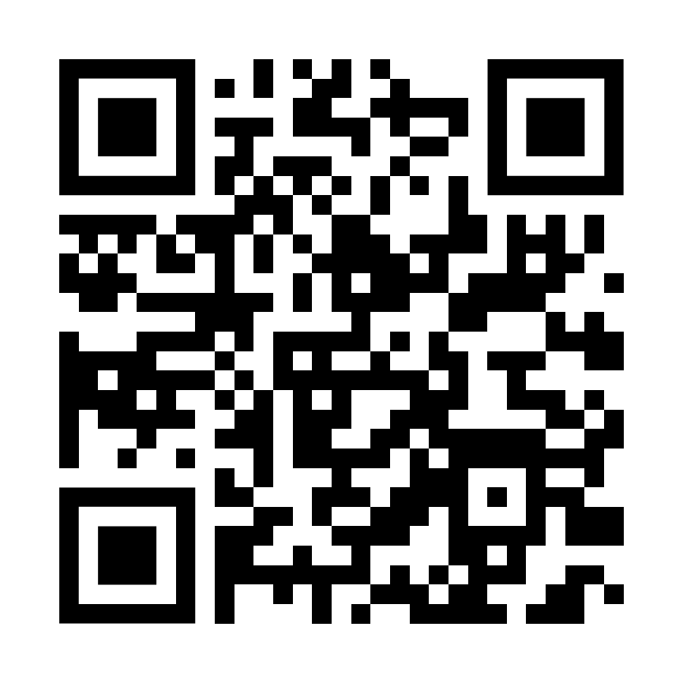
CANTOR8
EVERYTHING I JUST RAN
- SETUP.md
start here. Docker, ports, and Daml if you need it.
- README.md
the six-step lab I just demoed
- TROUBLESHOOTING.md
every error I hit while building it, with the fix
- daml-starter/
working contracts to copy from
github.com
/Cantor8
/hackathon-toolkit
Python, no installs. Ten minutes to your first transaction.
15 / 16

Slide 16
CANTOR8
BEST WAY TO GET HELP
Questions
- Show me the actual error, not a description of it
- Run: python3 c8lab.py check
it tells us which layer broke
- Ask early
a wrong plan at 2pm is cheap, at 7pm it is not
I am here all day. Come and find me.
16 / 16

